Slide 1
HTML Basics

Slide 2
Table of Contents
HTML Basics
Understand the structure of an HTML page.
New Semantic Elements in HTML 5
Learn to apply physical/logical character effects.
Learn to manage document spacing.

Slide 3
Understand the structure of an HTML page

Slide 4
HTML Basics
What is HTML?
HTML is a language for describing web pages.
It stands for Hyper Text Markup Language
HTML is a markup language and not a programming language
HTML uses markup tags to describe web pages.

Slide 5
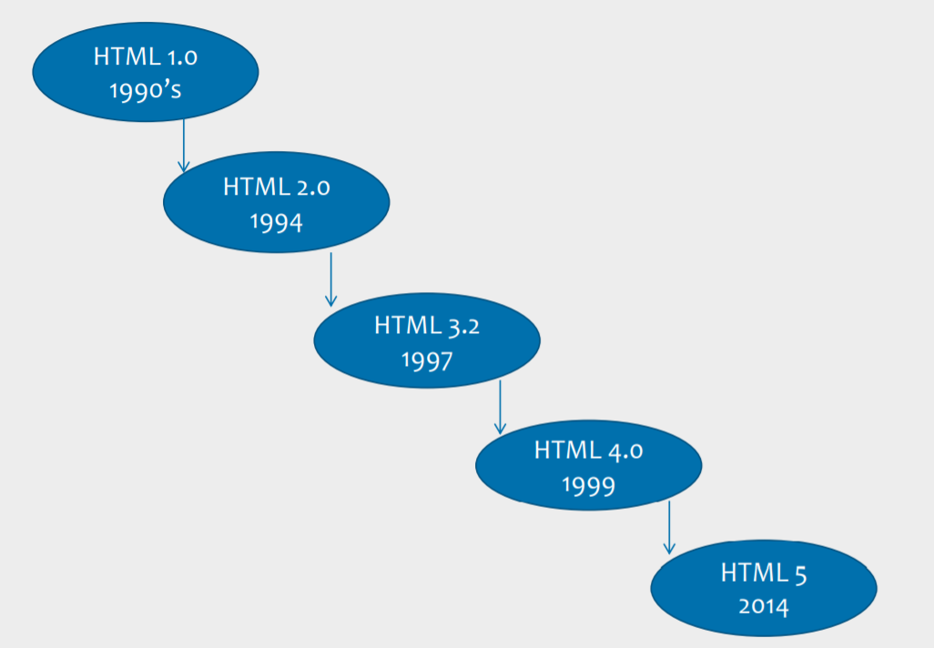
Evolution of HTML

Slide 6
HTML5 – The Good News !!!
Good support on modern mobile devices (iOS, Android)
Simpler, more intuitive syntax Video and Audio can be included without requiring a plug-in
Incremental improvements to previous HTML challenges
Much needed next step in HTML evolution
Creative enhancements: Rounded corners, gradients, text layout
Promising support of Mobile JS Frameworks (Sencha, jQTouch)

Slide 7
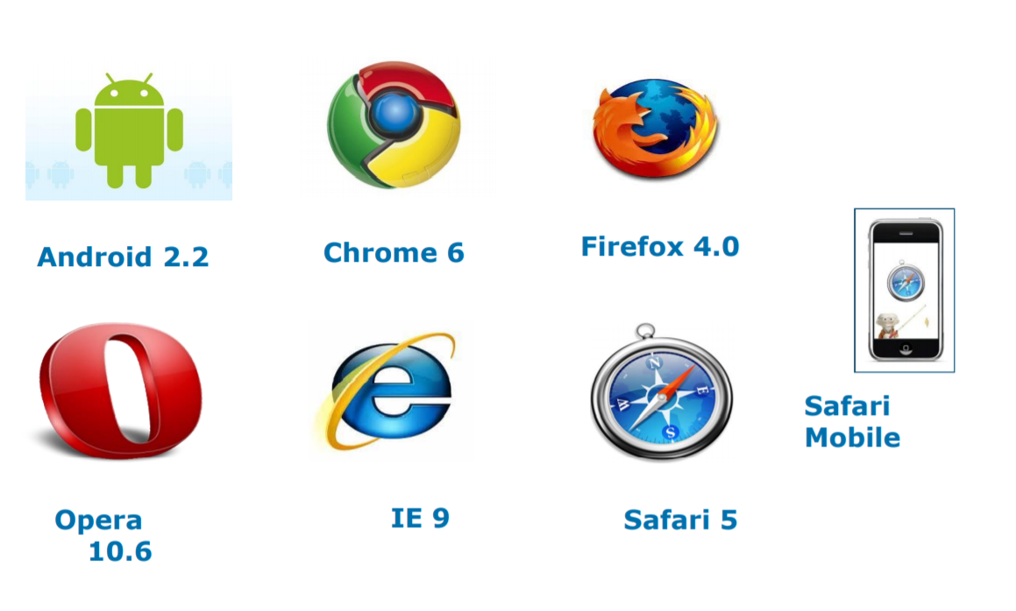
HTML5 – Browser Support

Slide 8
HTML Elements
Most Web documents are created using HTML.
Documents are saved with extension .html or .htm.
Tags are strings in the language surrounded by a less-than (<) and a
greater-than (>) sign.
Opening tag: <html> Ending tag: </html>
Can have Attributes
Attributes are Name-Value pairs added to HTML start tags.

Slide 9
Rules applicable for HTML5 Tags
Rules for HTML5 Tags are:
The document must included with an HTML5 DOCTYPE.
Tags and attriutes are case-insensitive.
Attributes do not need to be quoted.
End tags are not required for every element.
Some attributes may be empty such as checked and disabled .
For example, <input type=checkbox checked>
Only void elements such as br, img and link may be ”self-closed” with />.

Slide 10
HTML Elements (Code)
Code Snippet
An HTML document appears as follows:
<!DOCTYPE HTML>
<html>
<head>
<title>Title of page</title>
</head>
<body>
This is my first homepage. <b>This text is bold</b>
</body>
</html>

Slide 11
HTML Document Sections
HTML Head Section:
<head>…</head>
Page Title, Base URL, Meta Information
HTML Body Section:
<body>…</body>
Text, Images, Tables Colors, etc.

Slide 12
Head Section: Page Title (Code)
Code Snippet
Document Title is displayed using <title>…..</title> tag.
<!DOCTYPE HTML>
<html>
<head>
< title>
My First Page
</ title>
</head>
</html>

Slide 13
DEMO
Firstpage.html

Slide 14
Head Section: Document Base URL
Code Snippet
<!DOCTYPE HTML>
<html>
<head>
<title> Document Base URL Manipulation </title>
<base href=“URL/”>
</head>
</html>
More Examples:
<base href=“http://www.state.edu/images/”>
<base href=“ftp://ftp.state.edu/images/”>

Slide 15
Head Section: Meta Information
The <meta> tag provides metadata about the HTML document such as
descriptions and keywords for search engine.
Metadata will not be displayed on the page, but will be machine parsable.
Examples:
<meta …….>
<meta name="keywords" content="HTML, CSS” />
<meta name="author" content=“Username">
<meta http-equiv=refresh content=60 />
<meta http-equiv=refresh content=“20;url=c:/html/htm3.htm” />
<meta charset="UTF-8">

Slide 16
DEMO
Meta.html

Slide 17
HTML Body Section
<body> Element:
Represents information content.
Each document can have at most one <body> element.
Body element is placed between </head> and </html> elements.
Attributes supported in <body> element are:
Event Handler attributes like ononline, onoffline, onunload, onpagehide, onpageshow, etc..
Global attributes like id, style, class, hidden, lang, etc..

Slide 18
Document (Body) Contents
Body Text
HTML truncates spaces in your text.
Use <br> to insert new lines.
Use <p> tag to create paragraphs.
Other Elements of Body Section:
<table> tags are used to create tables.
<img> tags are used to insert images.

Slide 19
Comments in HTML Document
Increase code readability.
Ignored by the browser.
Example of HTML comment:
<!-- This is a Sample HTML Comment -->

Slide 20
DEMO
Body.html

Slide 21
Home Page Concepts
Most popular home pages reflects the personality of the sponsoring organization or corporation.
Keep the initial home page short and to the point.
First element visitor sees is a collection of navigation buttons to navigate to other pages.
When you publish a URL in print or any other marketing material, it points to the location of your home page.

Slide 22
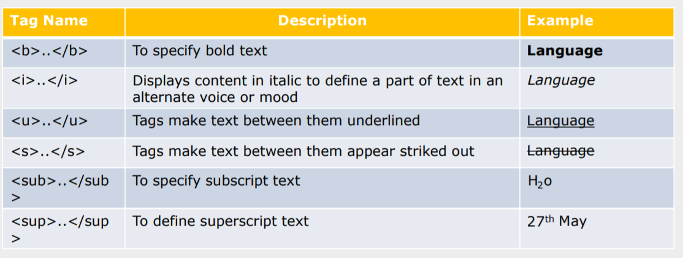
Physical Character Effects
Tags applies physical character effects by formatting the characters are listed below:

Slide 23
DEMO
PhysicalCharacterEffect.html

Slide 24
Logical Character Effects
Heading Styles:
<hn>…………</hn>
Value of n can range from 1 to 6
Syntax <h1>This is level 1 heading</h1>

Slide 25
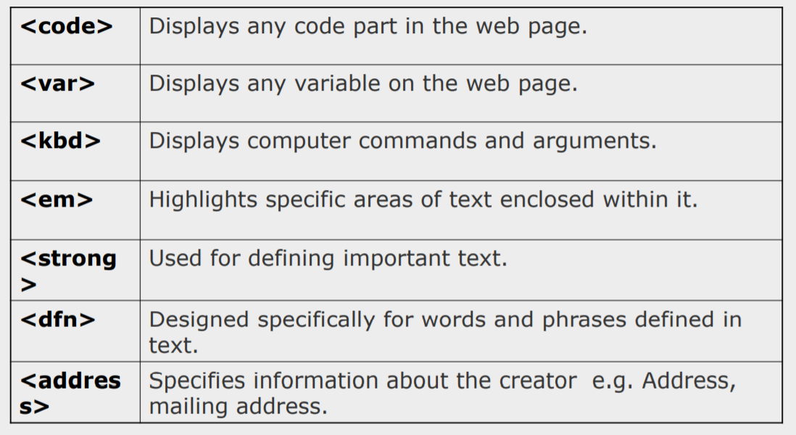
Logical Character Effects (Contd…)

Slide 26
Special Characters in HTML
Character Entities
Comprise following three parts:
Ampersand (&),
Entity name or a #
Character code
Semicolon (;)
Included in HTML page using:
Character code/Entity number: Include any character using its ISO Latin 1 character code.
To display “>” symbol, character code is 62 i.e. &#62;

Slide 27
Managing Document Spacing
Horizontal Spacing
Use <hr> tag for including horizontal rule in an HTML document
Vertical Spacing
<p>: Paragraph Break
<br>: Line Break
Notes:
Managing Document Spacing

Slide 28
DEMO
LCharacterEffects.htm
Spacing.html

Slide 29
Preformatted Text (Code)
<pre>…</pre> Tags display preformatted blocks of text with a fixed-space
font.
<pre> tag displays text with white space, line breaks, and tabs.
Examples:
<!DOCTYPE html>
<html>
<head><title> Preformatted Text</title>
<body>
<pre>Browser would display this paragraph as you are viewing here. No need to provide line or paragraph breaks.
</pre>
</body>
</html>
Notes:
Managing Document Spacing

Slide 30
Divisions in an HTML Document (Code)
The <div> tag defines a division or a section in an HTML document.
The <div> tag is used to group block-elements to format them with CSS.
Syntax:
<div>………..</div>
Example:
<!DOCTYPE html>
<html>
<body>
<div style=“text-align: center”>Text is center aligned.</div>
<div style=“text-align: left”>Text is left aligned.</div>
</body>
</html>
Notes:
Managing Document Spacing

Slide 31
<span> in an HTML Document
The HTML tag is used for grouping and applying styles to inline elements.
The span tag is used with inline elements whilst the div tag is used with block-level content.
Example:
<!DOCTYPE html>
<html>
<body>
HyperText Markup Language is the standard markup language
used to create <span style="color:blue;font-weight:bold">
static </span> web pages </body>
</html>
Notes:
Managing Document Spacing

Slide 32
Block level element
Block elements separate content into blocks
Each block element is displayed on its own with a line break before and after it
Example for block elements are <p>,<div>, <ol>, <ul>, <li> etc..
<div> element is a block level element that can be used as a container for other HTML elements

Slide 33
Inline element
Inline elements wont separate content into blocks
Inline elements are normally displayed without line breaks.
Inline element is just displayed in the flow of the paragraph
Example for Inline elements are <b>,<i>,<u>,<em>, <a>, <td>, <img>,
etc..
<span> element is an inline element that can be used as a container for text.

Slide 34
Rules
All inline elements and text need to be nested inside another block element
before they can go in the <body> element
Block elements are not allowed inside an inline element
Keep block elements out of your <p> element
Put text and inline elements inside block elements before adding them to a
<blockquote>
For an example:
<ol> and <ul> can have only <li>
We can put text, inline elements or block elements inside <li>

Slide 35
Example of Inline and Block elements
<!DOCTYPE html>
<html>
<body>
<p>HyperText Markup Language is the standard markup
language used to create <span style="color:blue;fontweight:bold"> static </span> web pages. JavaScript is a
scripting language used to make web page content as
<span style="color:orange;fontweight:bold">dynamic</span>.</p>
</body>
</html>

Slide 36
New Semantic Elements in HTML 5

Slide 37
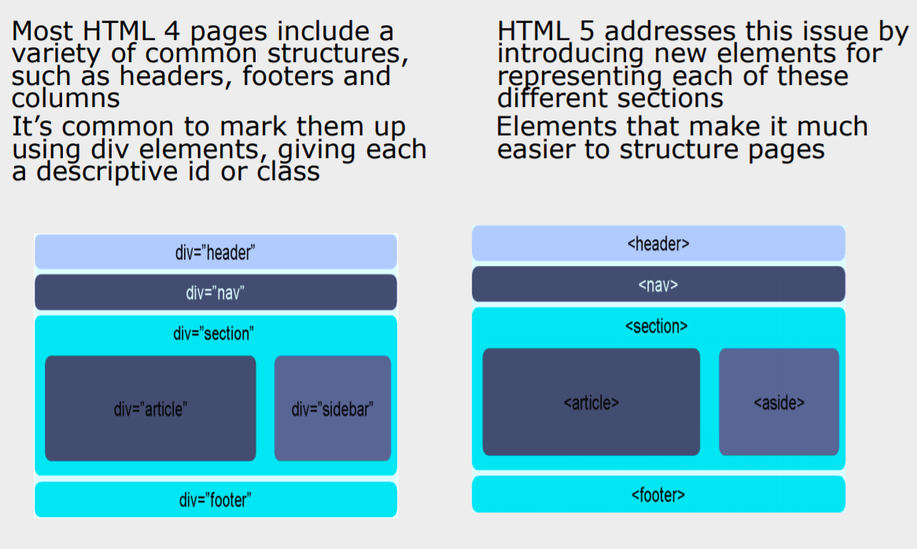
Laying out a page with HTML5

Slide 38
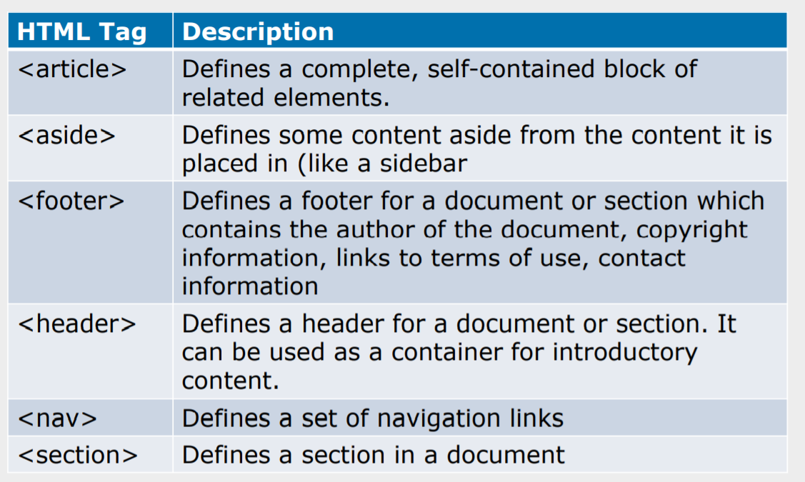
New Semantic Elements in HTML 5

Slide 39
DEMO
LayoutDemo.html

Slide 40
Summary
In this lesson, you have learnt about
The structure of an HTML page.
Physical/logical character effects
Managing document spacing.
New Semantic elements in HTML5

Slide 41
References
Books
Head First HTML with CSS
HTML 5 in action
HTML 5 and CSS 3
Html Pocket Reference
Links
http://imbolc.ucc.ie/~pflynn//books/htmlcard.html
http://www.w3.org/MarkUp/

